Slide 1




VISUAL BASIC.NET
Data Type System

Slide 2

Changes to Existing Data Types
Visual Basic 6.0 | Visual Basic .NET
Integer | Short
Long (32 bits, signed) | Integer
(none) | Long (64 bits, signed)
Variant | Not supported: use Object
Currency | Not supported: use Decimal
Date | No longer stored as a Double
String (fixed length) | Not supported
Notes:
Use CType function to convert data types

Slide 3
New Data Types
Visual Basic .NET data type | Storage size | Value range
Char | 2 bytes | 0 to 65535 (unsigned)
Short | 2 bytes | -32,768 to 32,767
Decimal | 12 bytes | Up to 28 digits on either side of decimal (signed)

Slide 4
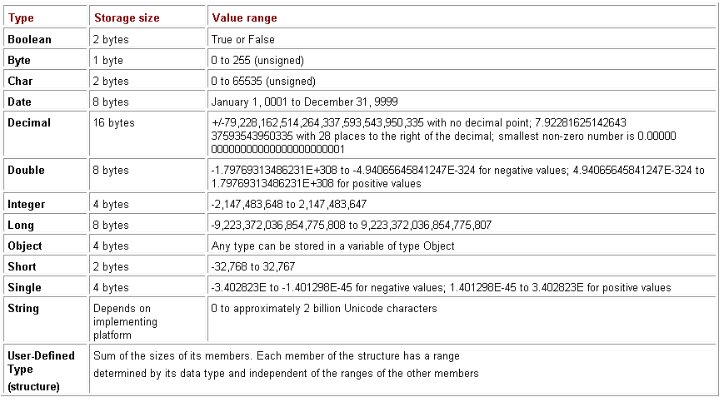
New Data Types

Slide 5
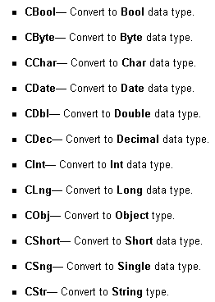
Converting between Data Types

Slide 6
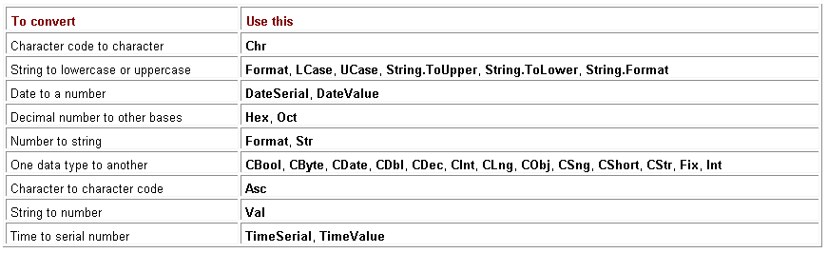
Visual Basic data conversion functions

Slide 7
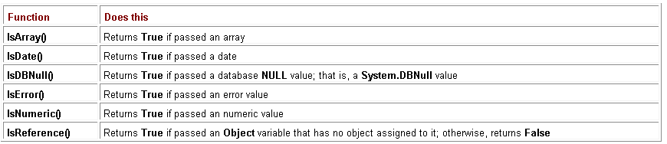
Checking Data Types

Slide 8
Variables
What is a Variable?
A variable is the named storage location that can contain data that can be modified during program execution. Each variable has a name that uniquely identifies it within its level of scope. A data type can be specified or not.
Declaring Variables :
    A Variable can be declared using Dim/ Private / Public statement.
    Scope and Lifetime of a variable depends on where that variable is declared.

Slide 9
Variables
    Dim Variablename [ As Type ]
      Optional As Type clause allows you to define the data type of a variable.
      If Type is not specified, Visual Basic makes the variable the default data type.
      The default data type is Object.

Slide 10
Declaring Multiple Variables
Declaring multiple variables in Visual Basic 6.0
Declaring multiple variables in Visual Basic .NET
Dim I, J, X As Integer
'Results in I and J As Variant, X As Integer
Dim I, J, X As Integer
'Results in I, J, and X As Integer

Slide 11
Variable Scope
Procedure scope
  Variables accessible to entire procedure
Block scope
  Variables only accessible within that block
  Lifetime of block variable is entire procedure
Dim iLooper As Integer 'Procedure level variable
For iLooper = 1 to 10
Dim iMax As Integer 'Block level variable
iMax = iLooper
Next
MsgBox (iMax) 'This line generates a compiler error

Slide 12
String
Dim Sampletxt as String
Sampletxt=“C-DAC”
Sampletxt=“DOOR O DAC ”
Sampletxt=“”

Slide 13
Object
Previous versions of Visual Basic supported the Variant datatype, which could be assigned to any primitive type (except fixed-length strings), Empty, Error, Nothing and Null. In Visual Basic.NET, the functionality of the Variant and Object datatypes is combined into one new datatype: Object. The Object datatype can be assigned to primitive datatypes, Empty, Nothing, Null, and as a pointer to an object.

Slide 14
If...Then
Use an If...Then block to execute one or more statements conditionally. You can use a single line syntax or multiple line block syntax
Syntax:-
IF Condition Then Statement
If Condition Then
Statement block
End If

Slide 15
If...Then...Else
An If ...Then...Else block is used to define several blocks of statements, one of which gets executed.
If Condition1 Then
Statement block1
[ElseIf Condition2 Then
[ Statement block2] ]
.[Else
[Statement blockn] ]
End If€

